Slide 1
ISA-INGENIOUS
Project Title: Safety Assistant
Team: Star Techies
Group members:
Siddhant Pawar
Pavan Bhadane
Ayush Singh Negi
Rohit Patil
Gayatri Aurangabadkar

Slide 2
Introduction
Road accidents or road safety is one of the major concerns in our country.
Lack of facilities for immediate treatment to victims leads to many deaths.
There are 53 road accidents in the country every hour and one death every four minutes.
An emergency service system to the victims can be extremely helpful to reduce economic and human loss due to these accidents.

Slide 3
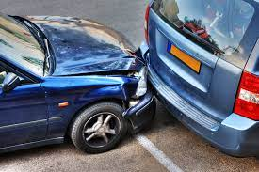
Problem statement
Personal vehicles these days offer a viable answer for customized traveling experience, however, the rising number of vehicles has exacerbated the matter as it prompts lots of traffic congestion problems and thus traffic accidents. All these accidents lead to enormous social and economic loses. To reduce the economic and human loss emergency services should become available immediately. So a system should be introduced which will keep track of the vehicle and notifies the emergency services as soon as the vehicle suffers from an accident.

Slide 4
Objective
To develop an auto accident detection system.
To provide an App interface to this system.
To integrate an emergency text message service.
To fetch the live location of the accident.
To detect alcohol consumption by the driver.
To detect fire accidents to inform fire extinguisher service.
To provide medical help to the victim.

Slide 5
Flow of system
SOS
Current live
location
SOS
Emergency services
Accident
detected
Live location
to near one’s
Call to ambulance
Start
Start
Fire detected
Live location to fire brigade

Slide 6
Sensor Workflow
Vehicle
On/off
IOT Layer
Accident
sensor
Gyroscope
sensor
Impulse
sensor
Fire detection
sensor
Flame
sensor
Smoke
sensor

Slide 7
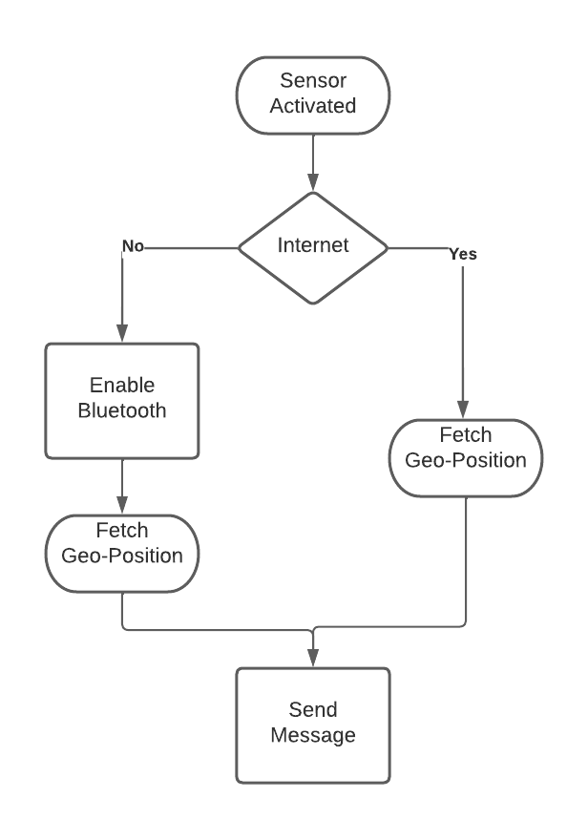
Some Basic Working Tech

Slide 8
Future Scope
Solving toll issues.
Integrating with driver health monitoring system.
Designing an equipment.
Prototype can be upgraded to Startup.

Slide 9
Conclusion
An automated notification service that allows authorities to be immediately aware of any accidents that occur in their respective cities to allow them to take immediate action and prevent as much damage as possible, both human and economic. The upcoming latest technology plays a major role for the same issue also at cheaper cost thus avoiding any casualty.

Slide 10
Thank You!
Team: Star Techies

